Slide 1
Real-Time Task Scheduling
By Group:
Ghassan Abdo Rayyashi
Anas to’meh
Supervised by
Dr. Lo’ai Tawalbeh

Slide 2
Outline
Real-Time System
Task categories
Why we need scheduling
Real time scheduling taxonomies
Scheduling Periodic Tasks
Real-Time Scheduling Algorithms
Static scheduling algorithms
Dynamic scheduling algorithms
Hybrid algorithm
referances

Slide 3
Real-Time System
Real-time systems have been defined as: “those systems in which the correctness of the system depends not only on the logical result of the computation, but also on the time at which the results are produced“
Correct function at correct time
Usually embedded
Deadlines
Hard real-time systems
Soft real-time systems

Slide 4
Real-Time System continue
Soft RTS: meet timing constraints most of the time, it is not necessary that every time constraint be met. Some deadline miss is tolerated.
Hard RTS: meet all time constraints exactly, Every resource management system must work in the correct order to meet time constraints. No deadline miss is allowed.

Slide 5
Tasks Categories
Invocation
Periodic (time-triggered)
Aperiodic (event-triggered)
Creation
Static
Dynamic
Multi-Tasking System
Preemptive: higher-priority process taking control of the processor from a lower-priority
Non-Preemptive : Each task can control the CPU for as long as it needs it.

Slide 6
Why we need scheduling ?!
each computation (task) we want to execute needs resources
resources: processor, memory segments, communication, I/O devices etc.)
the computation must be executed in particular order (relative to each other and/or relative to time)
the possible ordering is either completely or statistically a priori known (described)
scheduling: assignment of processor to computations;
allocation: assignment of other resources to computations;

Slide 7
Real-time Scheduling Taxonomy
Job (J_{ij}): Unit of work, scheduled and executed by system. Jobs repeated at regular or semi-regular intervals modeled as periodic
Task (T_{i}): Set of related jobs.
Jobs scheduled and allocated resources based on a set of scheduling algorithms and access control protocols.
Scheduler: Module implementing scheduling algorithms
Schedule: assignment of all jobs to available processors, produced by scheduler.
Valid schedule: All jobs meet their deadline
Clock-driven scheduling vs Event(priority)-driven scheduling
Fixed Priority vs Dynamic Priority assignment

Slide 8
Scheduling Periodic Tasks
In hard real-time systems, set of tasks are known apriori
Task T_{i} is a series of periodic Jobs J_{ij}. Each task has the following parameters
t_{i} - period, minimum interrelease interval between jobs in Task T_{i}.
c_{i} - maximum execution time for jobs in task T_{i}.
r_{ij} - release time of the j^{th} Job in Task i (J_{ij} in T_{i}).
ϕ_{i} - phase of Task T_{i}, equal to r_{i1}.
u_{i} - utilization of Task T_{i} = c_{i} / t_{i}
In addition the following parameters apply to a set of tasks
H - Hyperperiod = Least Common Multiple of p_{i} for all i: H = lcm(p_{i}), for all i.
U - Total utilization = Sum over all u_{i}.
Schedulable utilization of an algorithm U_{s}
If U < U_{s} the set of tasks can be guaranteed to be scheduled

Slide 9
Real-Time Scheduling Algorithms
Fixed Priority Algorithms
Dynamic Priority Algorithms
Hybrid algorithms
Rate Monotonic scheduling
Deadline Monotonic scheduling
Earliest Deadline First
Least Laxity First
Maximum Urgency First

Slide 10
Scheduling Algorithm Static vs. Dynamic
Static Scheduling:
All scheduling decisions at compile time.
Temporal task structure fixed.
Precedence and mutual exclusion satisfied by the schedule (implicit synchronization).
One solution is sufficient.
Any solution is a sufficient schedulability test.
Benefits
Simplicity

Slide 11
Scheduling Algorithm Static vs. Dynamic
Dynamic Scheduling:
All scheduling decisions at run time.
Based upon set of ready tasks.
Mutual exclusion and synchronization enforced by explicit synchronization constructs.
Benefits
Flexibility.
Only actually used resources are claimed.
Disadvantages
Guarantees difficult to support
Computational resources required for scheduling

Slide 12
Scheduling Algorithm Preemptive vs. Nonpreemptive
Preemptive Scheduling:
Event driven.
Each event causes interruption of running tasks.
Choice of running tasks reconsidered after each interruption.
Benefits:
Can minimize response time to events.
Disadvantages:
Requires considerable computational resources for scheduling

Slide 13
Scheduling Algorithm Preemptive vs. Nonpreemptive
Nonpreemptive Scheduling:
Tasks remain active till completion
Scheduling decisions only made after task completion.
Benefits:
Reasonable when
task execution times ~= task switching times.
Less computational resources needed for scheduling
Disadvantages:
Can leads to starvation (not met the deadline) especially for those real time tasks ( or high priority tasks).

Slide 14


Rate Monotonic scheduling
Priority assignment based on rates of tasks
Higher rate task assigned higher priority
Schedulable utilization = 0.693 (Liu and Leyland)
Where C_{i} is the computation time, and T_{i} is the release period
If U < 0.693, schedulability is guaranteed
Tasks may be schedulable even if U > 0.693

Slide 15

RM example
Period | Execution Time | Process
8 | 1 | P1
5 | 2 | P2
10 | 2 | P3
The utilization will be:
The theoretical limit for processes, under which we can conclude that the system is schedulable is:
Since the system is schedulable!

Slide 16
Deadline Monotonic scheduling
Priority assignment based on relative deadlines of tasks
Shorter the relative deadline, higher the priority

Slide 17
Earliest Deadline First (EDF)
Dynamic Priority Scheduling
Priorities are assigned according to deadlines:
Earlier deadline, higher priority
Later deadline, lower priority
The first and the most effectively widely used dynamic priority-driven scheduling algorithm.
Effective for both preemptive and non-preemptive scheduling.

Slide 18
Two Periodic Tasks
Execution profile of two periodic tasks
Process A
Arrives 0 20 40 …
Execution Time 10 10 10 …
End by 20 40 60 …
Process B
Arrives 0 50 100 …
Execution Time 25 25 25 …
End by 50 100 150 …
Question: Is there enough time for the execution of two periodic tasks?

Slide 19
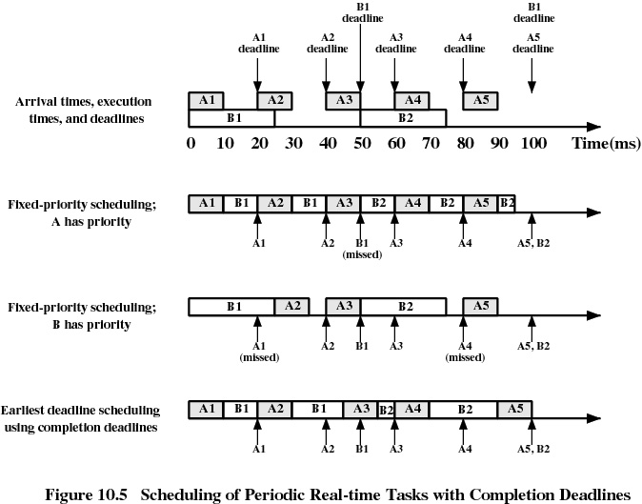

Slide 20
Five Periodic Tasks
Execution profile of five periodic tasks
Process | Arrival Time | Execution Time | Starting Deadline
A | 10 | 20 | 110
B | 20 | 20 | 20
C | 40 | 20 | 50
D | 50 | 20 | 90
E | 60 | 20 | 70

Slide 21
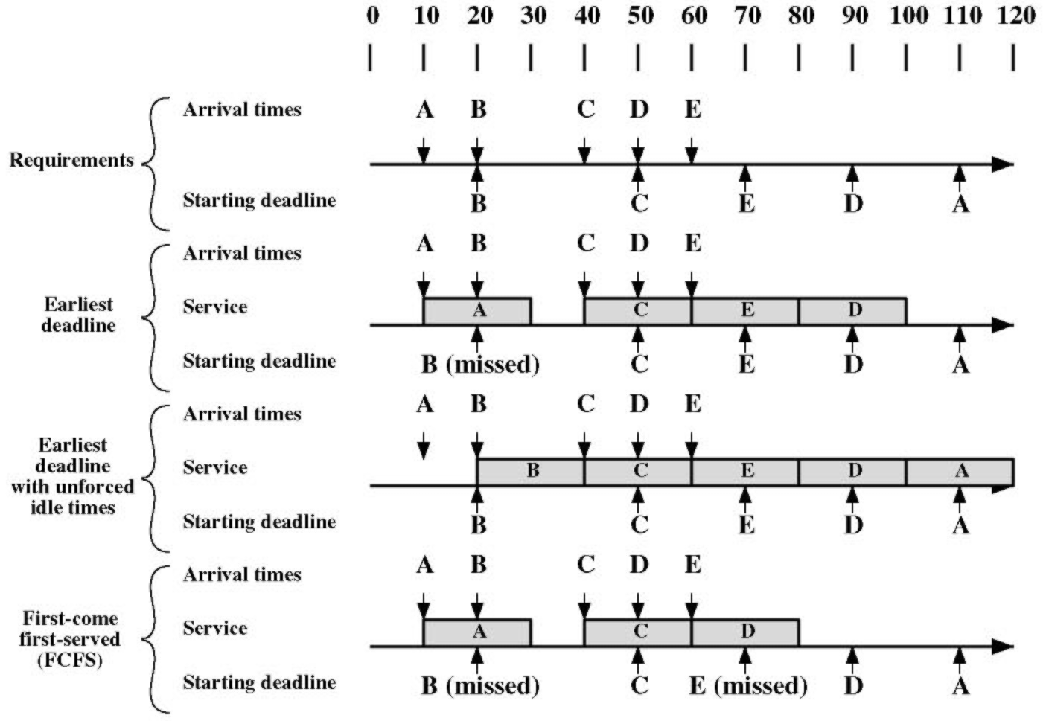

Slide 22
Least Laxity First (LLF)
Dynamic preemptive scheduling with dynamic priorities
Laxity : The difference between the time until a tasks completion deadline and its remaining processing time requirement.
a laxity is assigned to each task in the system and minimum laxity tasks are executed first.
Larger overhead than EDF due to higher number of context switches caused by laxity changes at run time
Less studies than EDF due to this reason

Slide 23
Least Laxity First Cont
LLF considers the execution time of a task, which EDF does not.
LLF assigns higher priority to a task with the least laxity.
A task with zero laxity must be scheduled right away and executed without preemption or it will fail to meet its deadline.
The negative laxity indicates that the task will miss the deadline, no matter when it is picked up for execution.

Slide 24
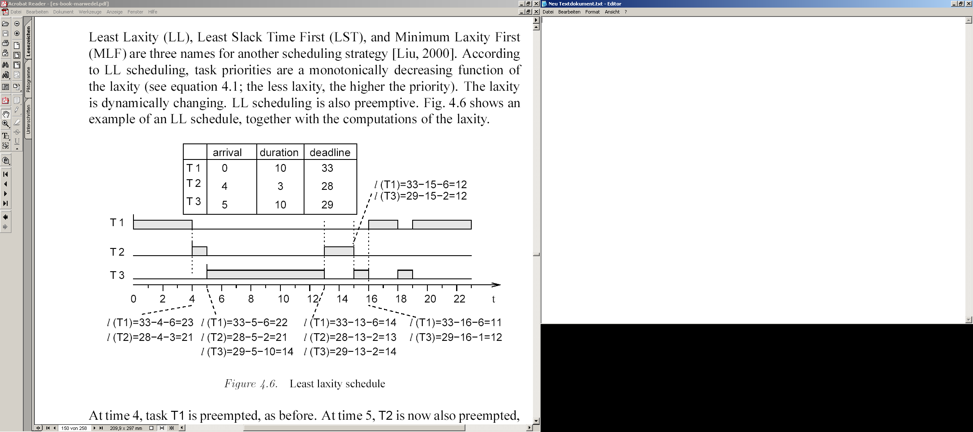
Least Laxity First Example

Slide 25
Maximum Urgency First Algorithm
This algorithm is a combination of fixed and dynamic priority scheduling, also called mixed priority scheduling.
With this algorithm, each task is given an urgency which is defined as a combination of two fixed priorities (criticality and user priority) and a dynamic priority that is inversely proportional to the laxity.
The MUF algorithm assigns priorities in two phases
Phase One concerns the assignment of static priorities to tasks
Phase Two deals with the run-time behavior of the MUF scheduler

Slide 26
Maximum Urgency First Algorithm phase 1
The first phase consists of these steps :
1) It sorts the tasks from the shortest period to the longest period. Then it defines the critical set as the first N tasks such that the total CPU load factor does not exceed 100%. These tasks are guaranteed not to fail even during a transient overload.
2) All tasks in the critical set are assigned high criticality. The remaining tasks are considered to have low criticality.
3) Every task in the system is assigned an optional unique user priority

Slide 27
Maximum Urgency First Algorithm phase 2
In the second phase, the MUF scheduler follows an algorithm to select a task for execution.
This algorithm is executed whenever a new task is arrived to the ready queue.
The algorithm is as follows:
1) If there is only one highly critical task, pick it up and execute it.
2) If there are more than one highly critical task, select the one with the highest dynamic priority. Here, the task with the least laxity is considered to be the one with the highest priority.
3) If there is more than one task with the same laxity, select the one with the highest user priority.

Slide 28
Questions ??

Slide 29
Referances
http://en.wikipedia.org/wiki/RTOS#Scheduling
http://en.wikipedia.org/wiki/Rate-monotonic_scheduling
http://www.netrino.com/Publications/Glossary/RMA.php

